Slide 1

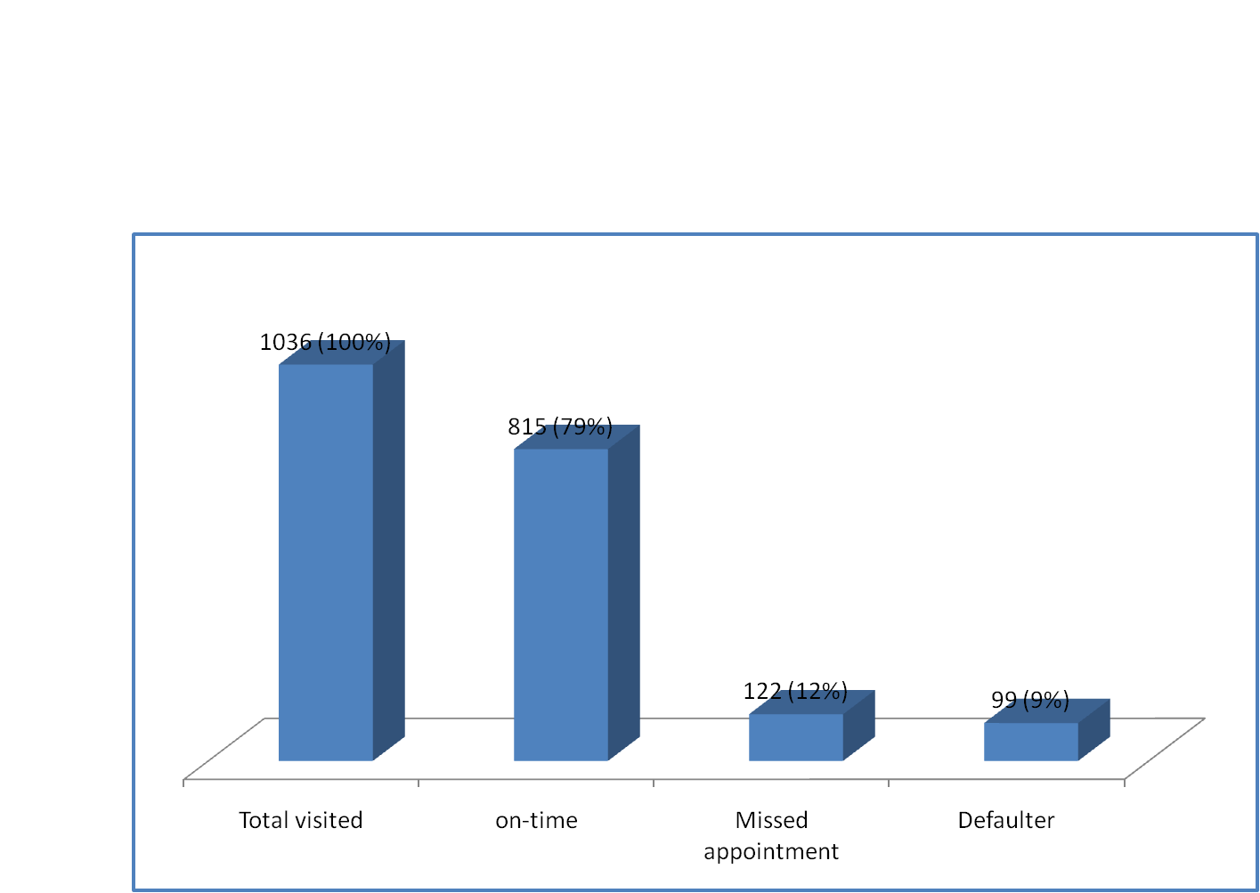

Clinic appointment n= 1036 (Aug 2014)
On-time=0-72 hrs, missed appointment= >3-14days, defaulter=15-89 days, >90 days =LTFU
www.lvcthealth.org

Slide 2
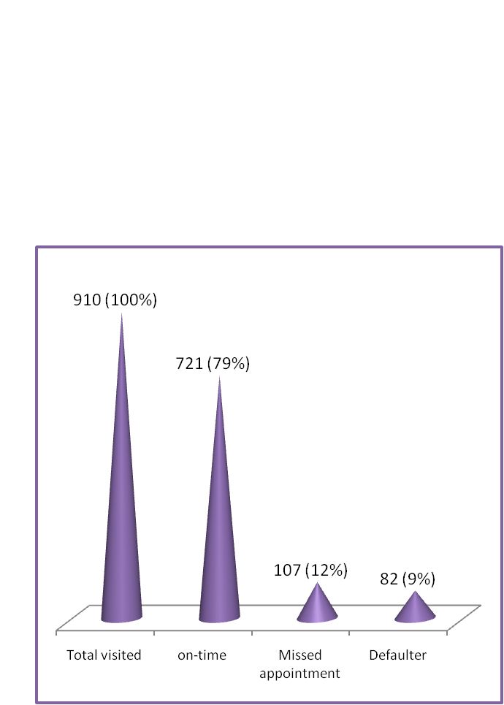
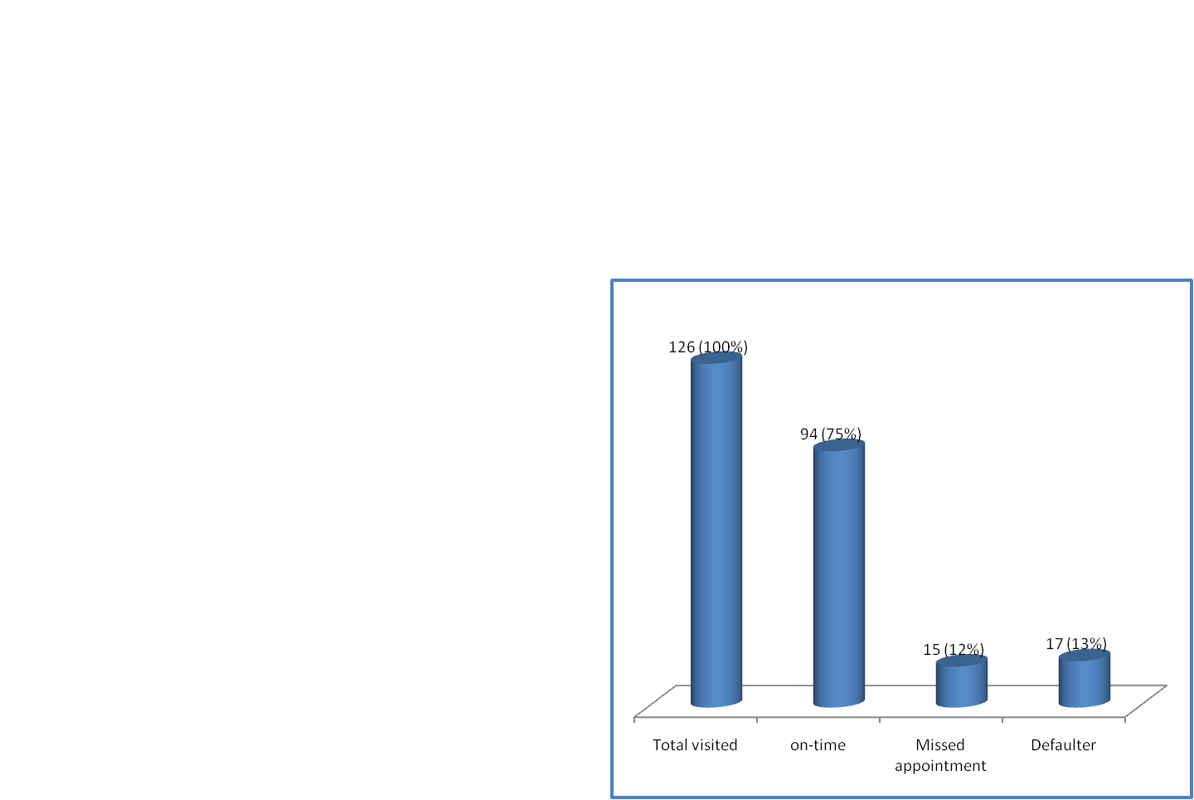
Clinic appointment n= 1036 (Aug 2014)
ART {n= 910 (88%)}
Non-ART {n=126 (12%)}
On-time=0-72 hrs, missed appointment= >3-14days, defaulter=15-89 days, >90 days =LTFU
www.lvcthealth.org

Slide 3
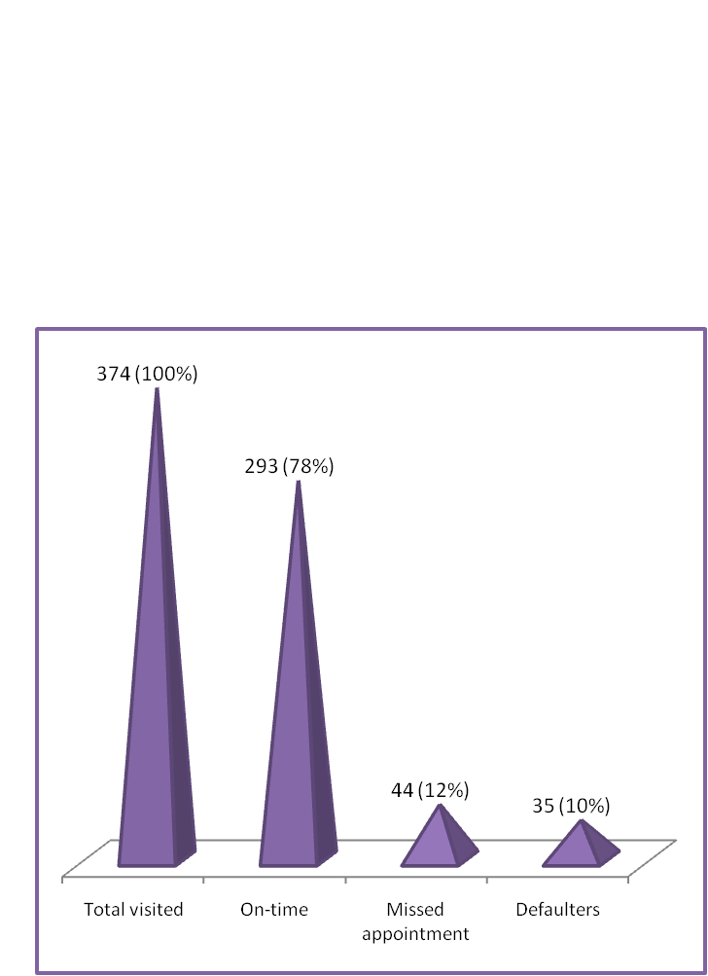
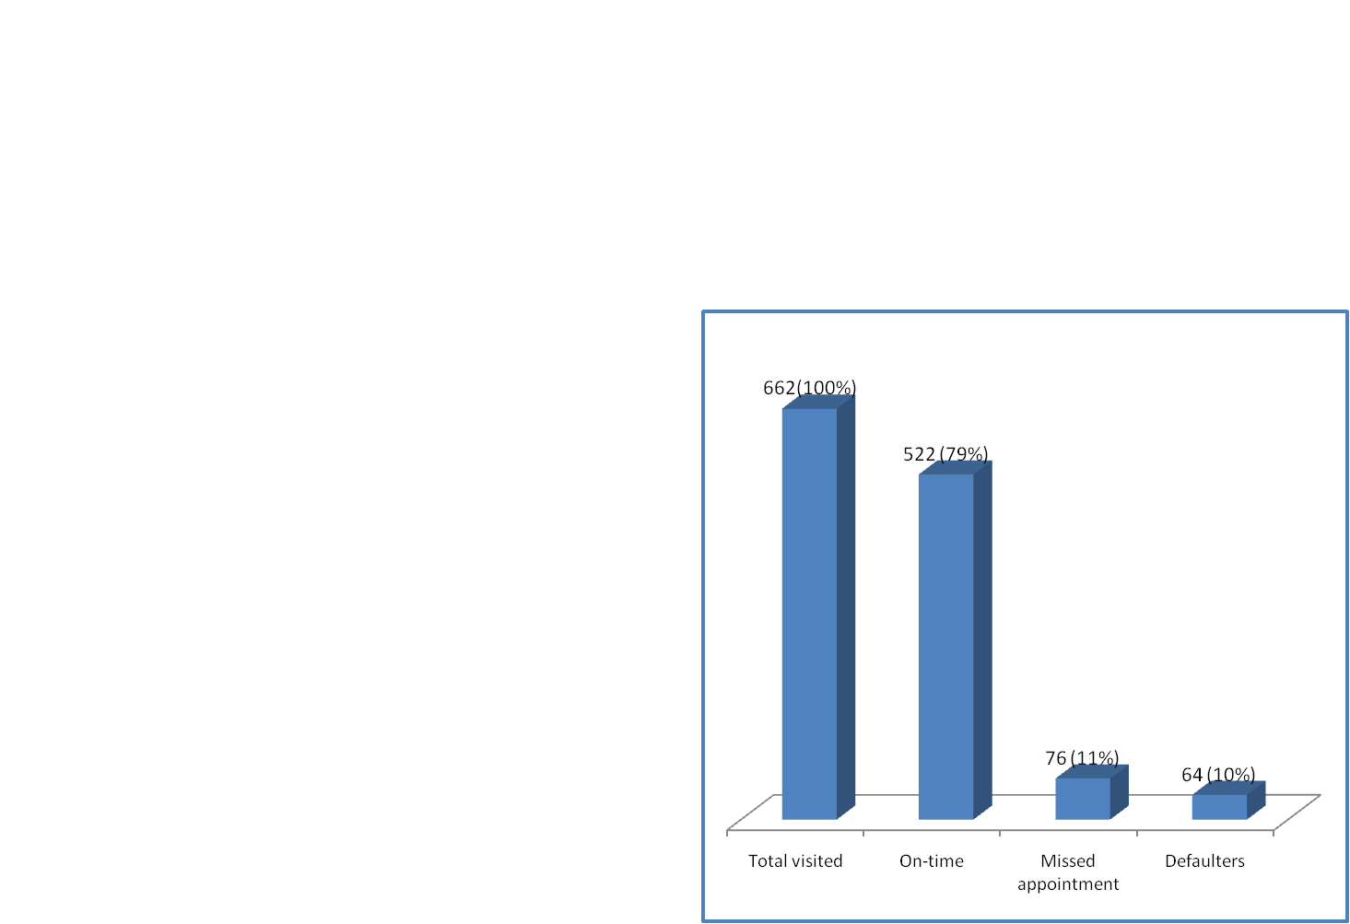
Clinic appointment n= 1036 (Aug 2014)
Male {n= 374 (36%)}
Female {n=662 (64%)}
On-time=0-72 hrs, missed appointment= >3-14days, defaulter=15-89 days, >90 days =LTFU
www.lvcthealth.org

Slide 4
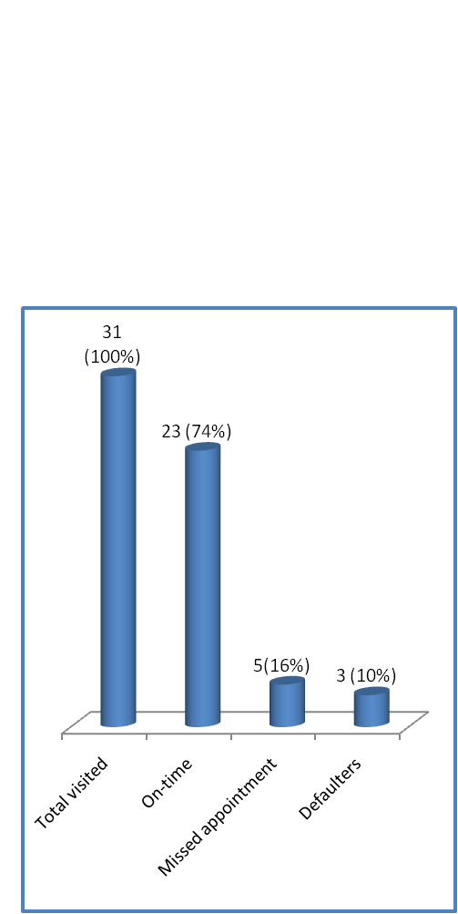
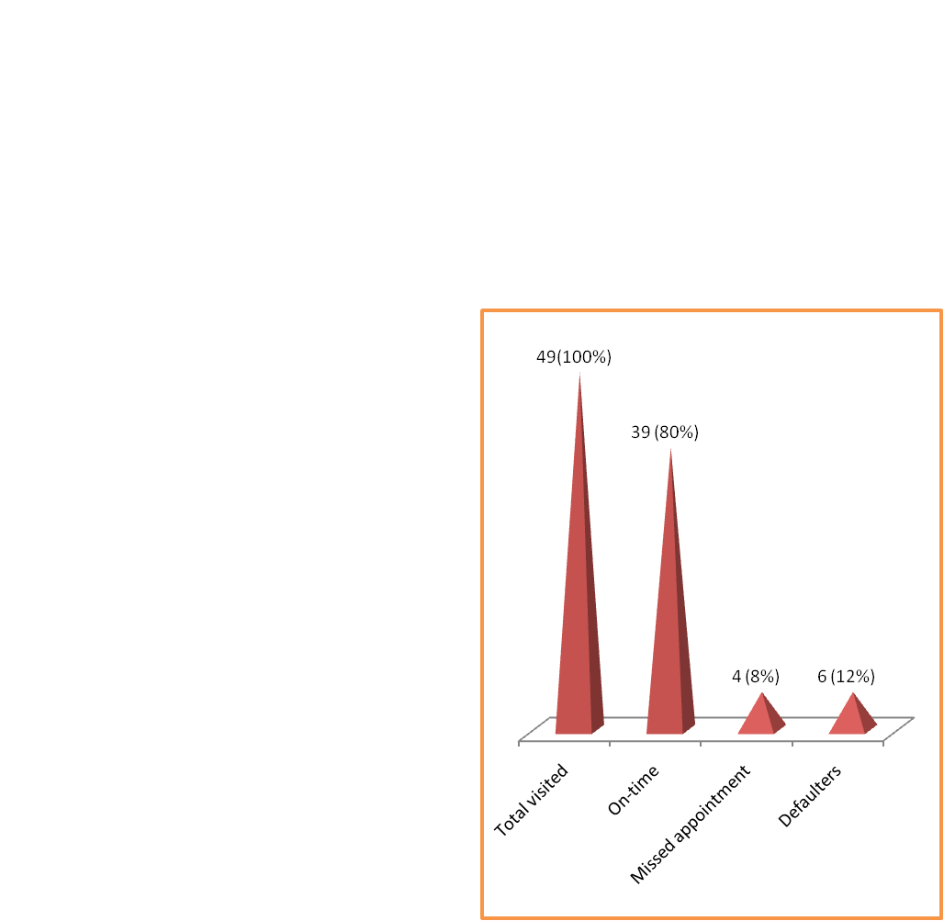
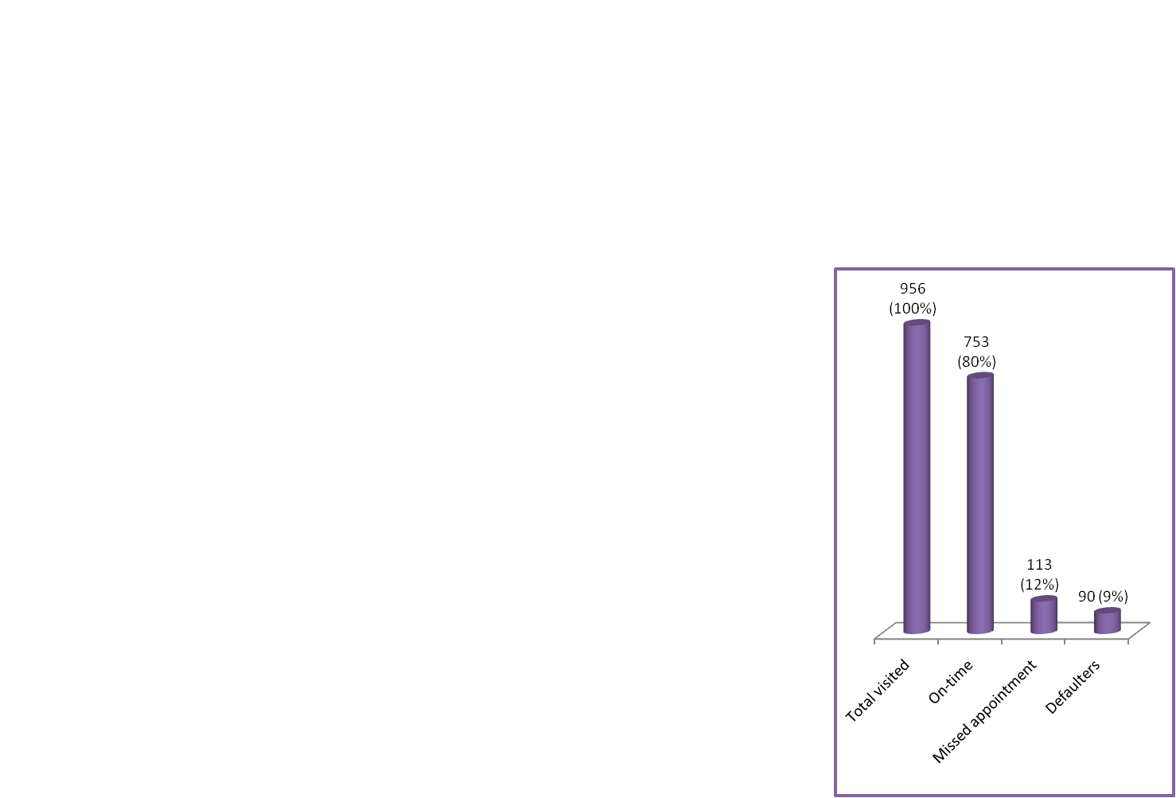
Clinic appointment n= 1036 (Aug 2014)
<15 yrs {n=31 (3%)}
15-24yrs {n=49 (5%)}
>24 {n=956 (92%)}
On-time=0-72 hrs, missed appointment= >3-14days, defaulter=15-89 days, >90 days =LTFU
www.lvcthealth.org

